Slide 1


Obesity Prediction
Sheema Selvam and Jayasree Jandhyala

Slide 2

Topics
Problem Statement
Description of Data
Preprocessing
Model Selection
Training and Testing
Conclusions

Slide 3
Problem Statement
Predict obesity category of an individual based on information about an individual
Underweight
Normal weight
Overweight
Obese
Information about an individual includes age, gender, height, weight, BMI and physical activity level.

Slide 4
Description of Data
1000 records with information on individuals with their age, gender, height, weight, BMI, physical activity level and obesity category.
4 obesity categories, multiclass prediction.
No missing values or bad data.
Data is well balanced, no obesity type, gender or physical activity level is under or overrepresented in the data.

Slide 5
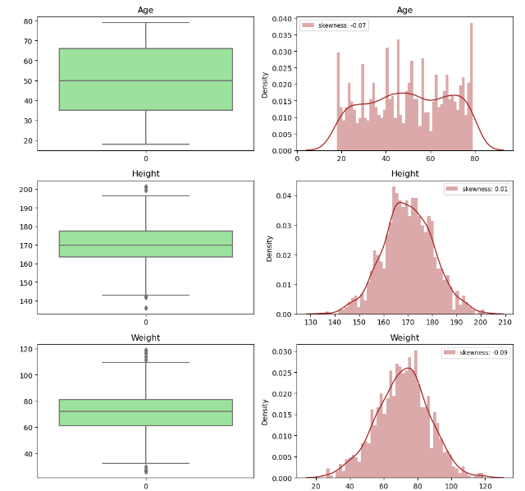
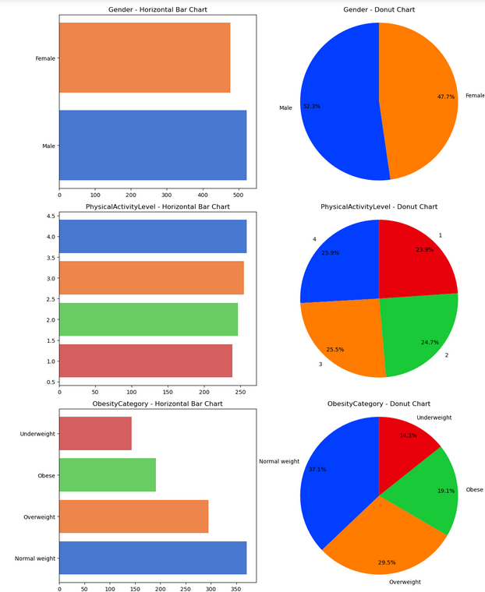
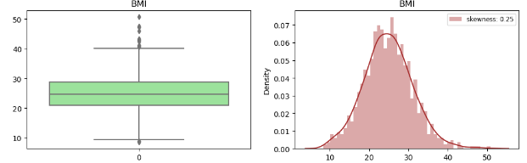

Slide 6
Pre-processing
To make the categorical variable “obesity” more friendly and usable we convert it to a numerical value.
Underweight -> 0
Normal weight -> 1
Overweight -> 2
Obese -> 3
Has natural ordering 0 < 1 < 2 < 3 or underweight < normal weight < overweight < obese.
Gender also represented through a binary variable 1/0.

Slide 7
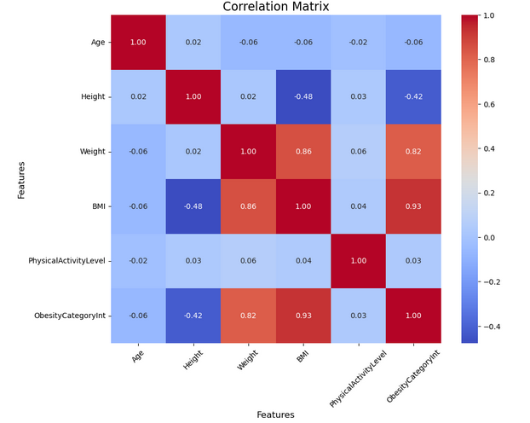
Model Selection
Few data points so we need to be careful with model choice.
Preprocessing data by converting categorical variables to integers allows us to compute correlations.
Height, weight and BMI are the most important features.
Relationship as seen in correlation matrix are quite intuitive.

Slide 8
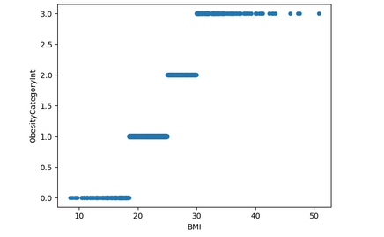
Model Selection
Consider the scatter plot between BMI and obesity category.
It is clear from here that the value of BMI uniquely predicts obesity category.
It appears that there is no “randomness” in this relationship.
A simple decision tree based only on BMI should be all we need !
We arrive at sample conclusion using forward/backward recursive attribute selection.

Slide 9
Training and Testing
We break down the data set into 80% train + validation and 20% test.
Our decision tree model requires choice of max depth for the tree which is a hyperparameter of the model.
We break the 80% data we set aside for train + validation into various cross validation sets to determine optimal max depth.
As expected, we find a depth of 2 is sufficient, this is because we only need to predict 4 categories and 4 intervals of BMI uniquely predict the 4 categories.
Model achieves 100% accuracy on the test set.

Slide 10
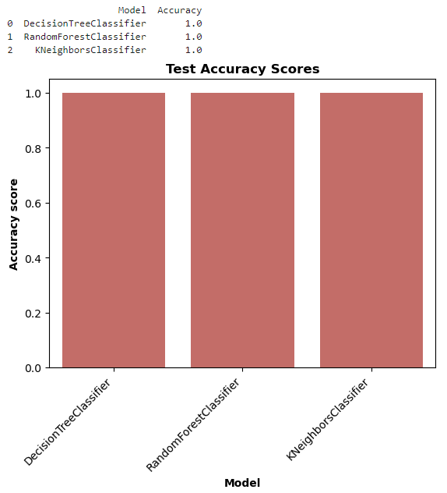
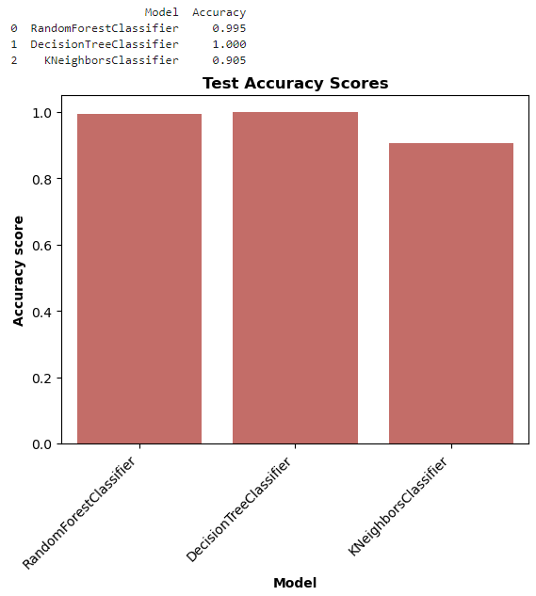
Conclusions
We compared accuracy across different types of models and found that only with BMI, we are able to achieve 100% accuracy with different models.
The current model is also better than any of the other models proposed by other Kaggle participants.
Other participants used all the variables as features and tried different non-linear models.
Domain knowledge and the right features with a simple model can sometimes do better than more complicated brute force models.

